Slide 1
Azure VM SQL Automated backup and patching
Rob Sewell

Slide 2
What is automated backup
Automatically backup sql user databases in azure virtual machine
Simple and easy to configure
Set it up when provisioning or add to existing machine
Reduce maintenance and set up

Slide 3
What is automated patching
Automatically install updates in azure virtual machine
Simple and easy to configure
Set it up when provisioning or add to existing machine
Reduce maintenance and set up

Slide 4
Automated backup
requires the SQL Server IaaS Agent
only supports SQL Server 2014 and Windows Server 2012 and 2012R2
maximum retention period of 30 days
Azure decides the freqency

Slide 5
There are some restrictions
Only database backups are supported
System databases are not supported so you need to back those up yourself
You can only back up to Azure storage
Maximum backup size is 1Tb as this is the maximum size for a blob in Azure storage
Simple recovery is not supported

Slide 6
A full backup is taken
when an instance is added to use Managed backup
When transaction log growth is 1Gb or more
At least once a week
If the log chain is broken
When a database is created

Slide 7
A transaction log backup is taken
If no log backup is found
Transaction log space used is 5Mb or larger
At least once every two hours
Any time the transaction log backup is lagging behind a full database backup. The goal is to keep the log chain ahead of full backup.

Slide 8
DEMO

Slide 9
Look out for
When you enable Automated Patching for the first time, Azure configures the SQL Server IaaS Agent in the background. During this time, the portal will not show that Automated Patching is configured. Wait several minutes for the agent to be installed, configured. After that the portal will reflect the new settings.

Slide 10
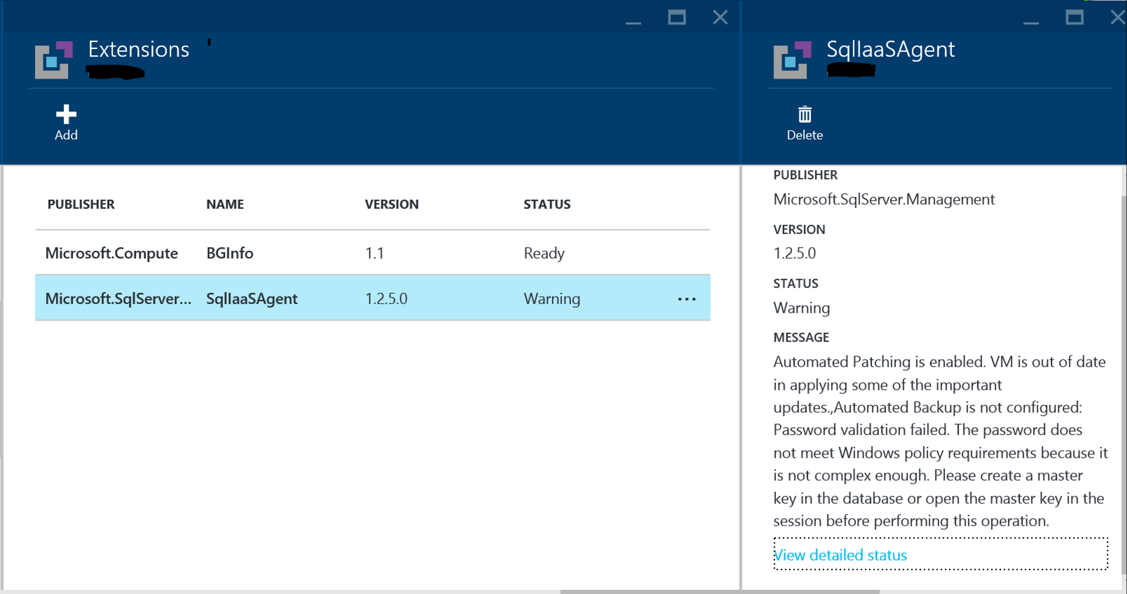
Look out for

